Slide 1


www.tarahtech.com

Slide 2

DATA MANIPULATION AND VISUALIZATION

Slide 3
DATA MANIPULATION AND VISUALIZATION
1) Data Manipulation:
  Filtering Data
  Selecting sub data
  Sorting Data
  Grouping Data
  Dates manipulations
  String Manipulations
  Joining datasets: a) Concatenation
  b) Merging Data

Slide 4
2) Data Visualization:
  a) Univariate visualization
    Histogram
    Boxplot
    Density Graph
    Distplot
  b) Bivariate visualization
    Bar Graph
    Stacked Graph

Slide 5
  Scatter plot
  Line Graph
  Hex plot
  Scatter matrix
c) Multivariate Visualization
  Lmplot
  Scatter plot

Slide 6
Data Manipulations
1.Filtering Data:
  For subsetting a data frame based on one or more values of a column or rows, filtering data comes handy.
  Example: The dataset(E-commerce) of 8523 rows and 12 columns. When data of column’s specific value(Dairy in Item_type) is required, then filtering is used.
  # filtering data set for rows where item_type=Dairy
[ filter = data[data.Item_Type=='Dairy'] ]
2.Selecting Data:
  While working on data, sometimes we need to take subsets of the whole data or subset of the data.
  In such cases, we select the required data, using select() function.

Slide 7
  Example; Taking the previous E-commerce dataset, which has 8523 rows and 12 columns. We want only columns of Item_type and Item_MRP, in such cases we use select function.
  #to select columns item_type and item_mrp
  [ select1=data[['Item_Type','Item_MRP']] ]
3.Sorting Data:
  Sorting Data is sorting continuous variables in ascending and descending order, categorical variables in alphabetic order.
  To sort data frame based on the values of one or more columns or sort based on the values of row index or row names of pandas data frame, we can use these two functions.
  sort_values(): to sort pandas data frame by one or more columns
  sort_index(): to sort pandas data frame by row index

Slide 8
#sorting on continuous value
  [ sort1=data.sort_values('Item_Weight') ]
#sorting on categorical values is done in alphabetical order
  [ sort2=data.sort_values("Item_Fat_Content") ]
#sorting on continuous values
  [ sort3=data.sort_values('Item_Weight',ascending=False) ]
#sorting on two values; one in ascending and the other in descending
  [sort4=data.sort_values(['Item_Weight','revenue'],ascending=[True,False])]

Slide 9
Grouping Data:
  Groupby essentially splits the data into different groups depending on a variable of your choice.
  For example, expression data.groupby(‘Item_type’) will split our current DataFrame by Item_type.
  On these splits aggregation functions(mean(),sum(),count()) can be performed.
#To find mean of a grouped data
  [ mean_item_mrp=data.groupby("Item_Type")["Item_MRP"].mean() ]
# finding mean for every item according to their weights
  [ mean_x=data.groupby(["Item_Type","Item_Weight"])["Item_MRP"].mean() ]

Slide 10
Date Manipulation:
  When a csv file is imported and a Data Frame is made, the Date time objects in the file are read as a string object rather a Date Time object
  Hence it’s very tough to perform operations like Time difference on a string rather a Date Time object.
  Pandas to_datetime() method helps to convert string Date time into python Date time object.
  [ flt['FlightDate'].head(2) ]
  result: 0 01-Jan-14
  1 01-jan-14
  [ flt["FlightDate"]=pd.to_datetime(flt["FlightDate"],format="%d-%b-%y").head(2) ]
  result 0 2014-01-01
  1 2014-01-01

Slide 11
String Manipulations:
  There are many built in functions to manipulate the strings in the dataset.
  Examples; len(), count(), find(), index(), replace(), reversed()
  These functions are used to describe and manipulate strings.
  [ print(book["income"].head(2)) ]
  result:0 51/-
  1 52/-
  [ print(book["income"].str.replace("/-","").head(2) ]
  result:0 51
  1 52

Slide 12
Joining datasets
  a) Concatenation:
    Concatenation of two or more datasets is done by using function concat().
    Datasets with same number of rows are concatenated with axis 1, which will combine all there columns, resulting in increase of columns.
    Whereas, axis 0 is used, datasets are combined vertically, increasing the row numbers.
    Let us take 4 datasets; data1(5000,12),data2(3523,12),data3(8523,5) and data4(8523,7)
    #concatenating rows
    [ print(pd.concat([datar1,datar2],axis=0).shape) ] result;(8523,12)
    #concatenating columns
    [ print(pd.concat([datac1,datac2],axis=1).shape) ] result:(8523,12)

Slide 13
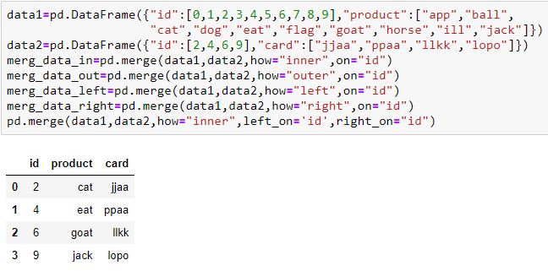

b) Merging Datasets
  Merge is an important tool to have because it allows you to efficiently combine data tables together in a nice and orderly fashion.
  It can merge either inner(), outer(), left() or right() of the datasets.

Slide 14
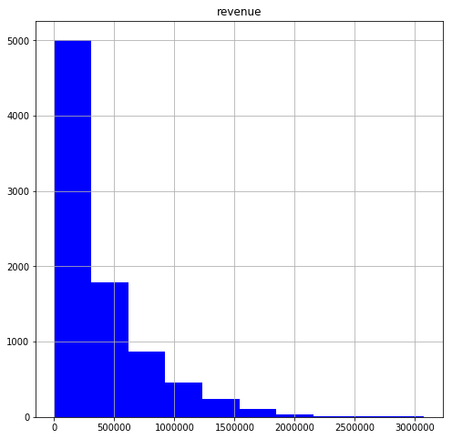
Data Visualization
Univariate Visualization:
  1.Histogram
    A histogram is a plot that lets us discover, and show, the underlying frequency distribution of a set of continuous data.
    #histogram on continuous variable
    [ data.hist(column="revenue", figsize=(8,8), color="blue", bins=10) ]

Slide 15
2. Boxplot
  A Box Plot is the visual representation of the statistical five number summary of a given data set.
    A Five Number Summary includes:
      a)Minimum
      b)First Quartile
      c)Median (Second Quartile)
      d)Third Quartile
      e)Maximum
  This is also used to know about the outliers in a dataset.

Slide 16
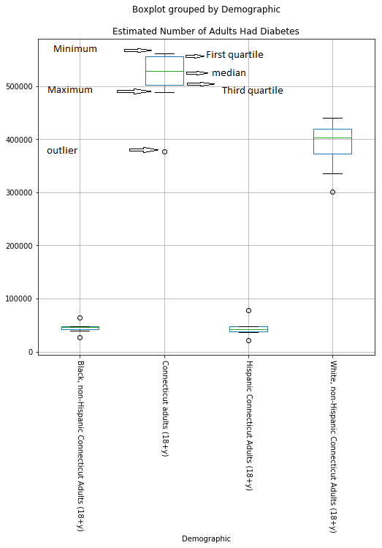
[ data.boxplot(column="Estimated Number of Adults Had Diabetes", by= "Demographic", figsize= (8,8),rot=270, grid=True) ]

Slide 17
3.Density Graph
  A density plot shows the distribution of a numerical variable.
  It takes only set of numeric values as input.
  To represent a density, you need only one vector of numbers.
  We can plot several densities for several numerical variable.

Slide 18
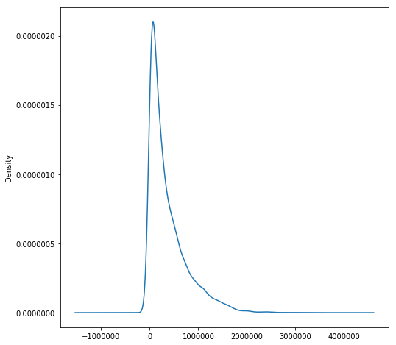
[ data["revenue"].plot(kind="density", figsize=(8,8)) ]

Slide 19
4.Dist Plot
  Dist plot allow us to plot density of variable over the histogram.
  It helps us to visualize both density and histogram of a variable.
  Distplot() is the function used to plot the graph.
  [ x=data[data.Item_Type=="Dairy"]
  sns.distplot(x["Item_weight"], hist=True, kde=True, bins=int(10), color = 'blue', hist_kws={'edgecolor':'black'}, kde_kws={'linewidth': 2.5}) ]

Slide 20
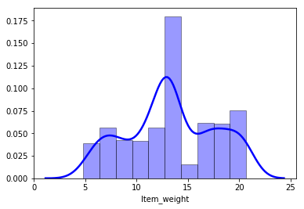

Slide 21
Bivariate visualization
  1.Bar chart
    Bar charts are a type of graph that are used to display and compare the number, frequency or other measure for different discrete categories of data.
    They consist bars which vary in size according to their values w.r.t y-axis(vertical graph) or x-axis(horizontal graph).
    It is used in Bi-variate analysis.

Slide 22
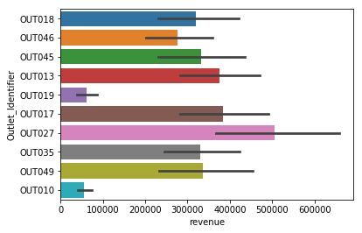
[ Import seaborn as sns
x=data[data.Item_Type=="Soft Drinks"]
sns.barplot(x= "revenue", y="Outlet_Identifier",data=x) ]

Slide 23
2.stacked Bar graph
  Stacked Bar Graphs segment their bars of multiple datasets on top of each other.
  They are used to show how a larger category is divided into smaller categories and what the relationship of each part has on the total amount.
  There are two types of Stacked Bar Graphs:
    a) Simple Stacked Bar Graph
    b) 100% Stack Bar Graphs

Slide 24
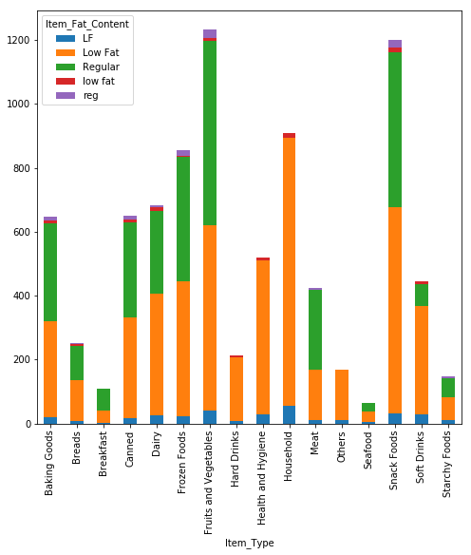
[ data_table = pd.crosstab(index=data["Percent of Adults with Diabetes"], columns=data["Demographic"])
data_table.plot(kind="bar",stacked=True,figsize=(8,8)) ]

Slide 25
3. Scatter plot
  Scatter plot has points that shows the relationship between two(bivariate) or more variables(multivariate) in a dataset.
  In case of more than two variables, it uses colour and shape to represent variables.
  [ plt.scatter(x=data["Data Years"],y=data["Percent of Adults with Diabetes"])
  plt.xticks(data["Data Years"],rotation="vertical") ]

Slide 26
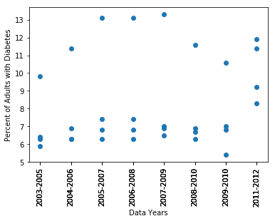
In the above scatter plot, the relationship between data Years and Percentage of adults with diabetes is visualized.

Slide 27
4.Line graph
  A line graph is a graphical display of information that changes continuously over time.
  Within a line graph, there are points connecting the data to show a continuous change.
  The lines in a line graph can descend and ascend based on the data.
  We can use a line graph to compare different events, situations, and information.
  A line graph has two axes.
  The x-axis of a line graph shows the occurrences and the categories being compared over time and the y-axis represents the scale, which is a set of numbers that represents the data and is organized into equal intervals.

Slide 28
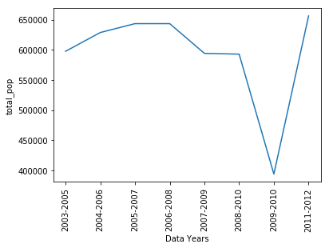
[ plt.plot(data_hisp["Data Years"],data_hisp["total_pop"])
plt.xticks(data_hisp["Data Years"],rotation="vertical")
plt.xlabel("Data Years"),plt.ylabel("total_pop") ]

Slide 29
5.Scatter matrix
  scatter matrix is used to visualize all the possible bi-variate scatter plots in a datasets.
  The diagonal of the matrix, which is plot of same variable on x and y-axis, can be used for viewing histogram or density plots.
  [ from pandas.plotting import scatter_matrix
  scatter_matrix(data,alpha=0.9,figsize=(10,10),diagonal="kde") ]

Slide 30
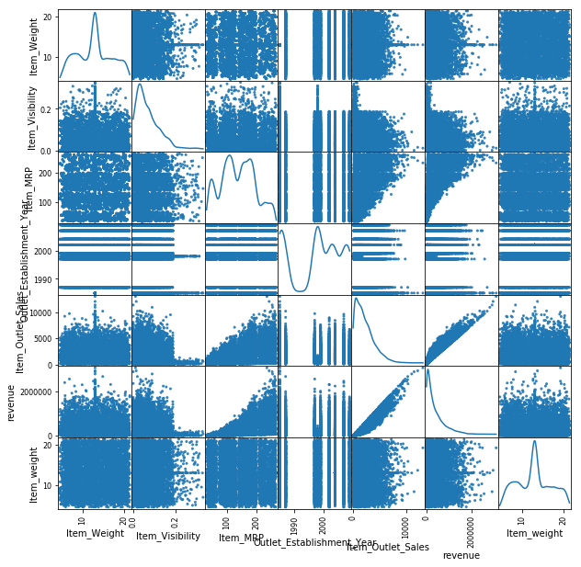
When diagonal= “hist”, we get histograms instead of density graphs.

Slide 31
Multi variate visualization
  1.Lmplot
    Lmplot gives the relationship between variables more than 2.
    Hue and col are used to represent the variables apart from x and y-axis.
    [ sea.lmplot(x='Item_MRP', y='Item_Outlet_Sales',hue='Outlet_Size', col="Item_Fat_Content",col_wrap=2, data=data2, fit_reg=True) ]
    Fit_reg= True/False helps in giving regression line for the data

Slide 32
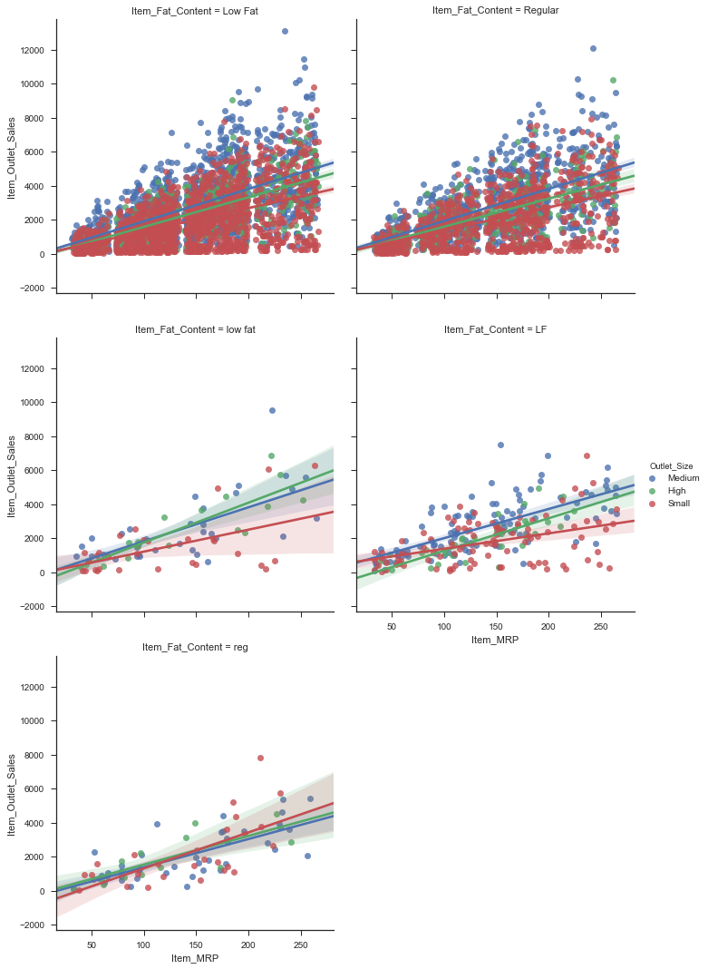

Slide 33
2.Scatter plot
  One of the best ways of visualizing the relationship between measures is to use a scatter plot.
  A scatter plot works by looking at the relationship between two different measures and subdividing it one or more different categories or dimensions.
  Parameters like color and size are used to represent different variables rather than x-axis and y-axis.
  Note: Color and size using for categorical variable is advisable, as numeric variables use lot of colors resulting in confusion and misunderstanding during visualization.

Slide 34
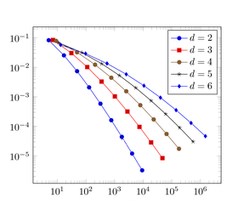
In the above graph, colour is used to represent different variable apart from x and y-axis.

Slide 35
Thank You

Slide 36
www.tarahtech.com

